Slide 1
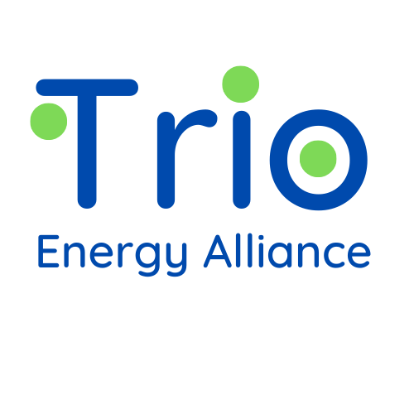

UNIVERSAL SHUNT EFFICIENCY SYSTEM
USES® MFG INC
www.trioenergyalliance.com

Slide 2
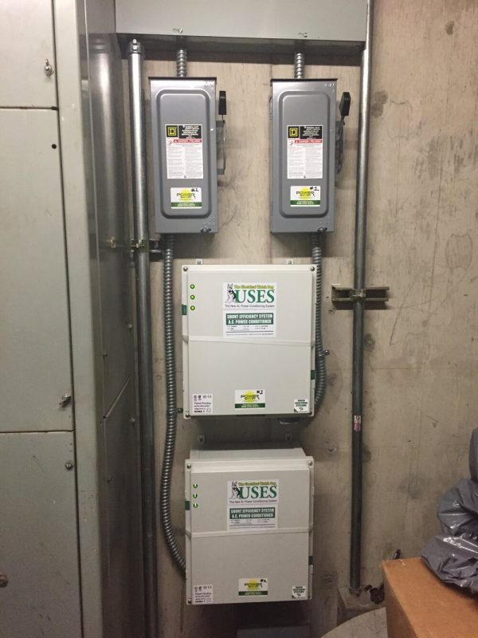
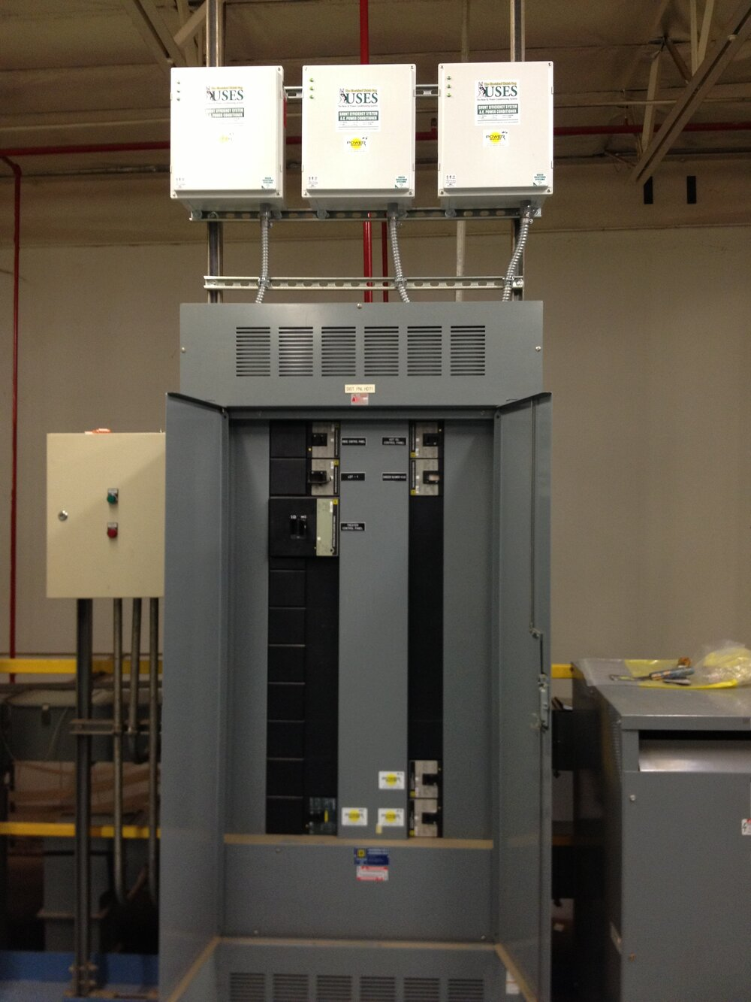
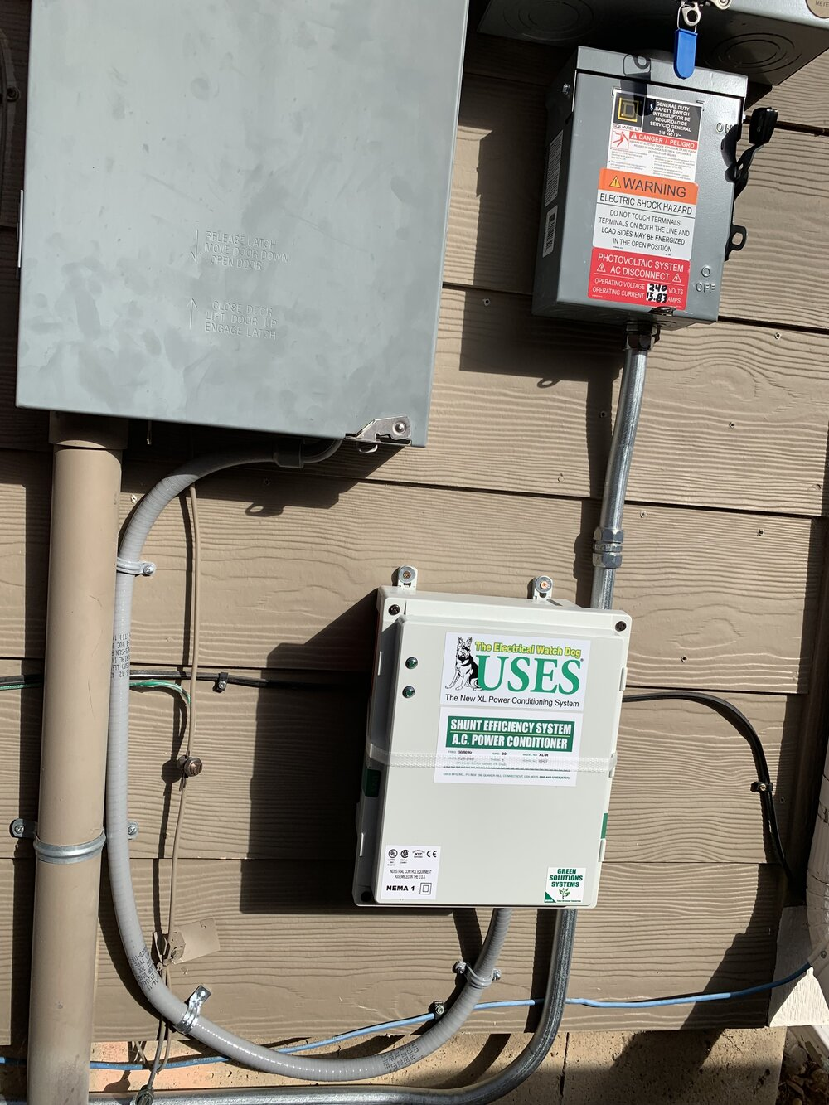
USES® INSTALLATIONS
www.trioenergyalliance.com

Slide 3
WHAT USES® DOES
Underwriters Laboratory's Characterization of the USES® Technology
Reduces Wattage
Reduces Line Current
Corrects Power Factor
Suppresses Voltage Surges and Spikes
Regulates Voltage
Improves Load Balance on all Phases
Reduces Neutral Line Current
Reduces Switch Mode Transients
Reduces Harmonic Currents
Reduces Magnetic Fields
www.trioenergyalliance.com

Slide 4
Certifications and Approvals
www.PowerShaver.com
Underwriters Lab [UL]: File #E132743 Category:5B81 Industrial Control Equipment
Canadian Standards Ass [CSA]: Category: LR99910 / Master Contract: 234841
Conformité Européene [CE Mark]: Directive 2006/95/EC: The Low Voltage Directive Standards: IEC 61558-1 Safety of power transformers, power supplies & similar products 2005
Patent Numbers:
US: 20120194313 - A.C. Power Conditioning Circuit
International: WO2012102691 – AC Power Conditioning Circuit
US: 5105327 – A.C. Power Conditioning Circuit
General Services Administration [GSA]: Schedule 70: General Purpose Commercial Information Technology Equipment, Software and Services: Cooperative Purchasing and Surge Suppressor
New York City Approval: Submission #: 92A0390
Funacion Institito de Ingenieria, Caracas, Venezuela: Electric and Electric System Engineering Center Test Report No, 24-000593
www.trioenergyalliance.com

Slide 5
Product Specifications
www.trioenergyalliance.com

Slide 6
Installation
Instructions
www.trioenergyalliance.com

Slide 7
How USES® Works – 5 Methods
The patented USES® technology is a dynamic, passive, res­onance-free magnetic field induction system that reduces kW demand and kWh consumption through five methods:
Magnetic phase balancing of voltage and current to safely reduce waste, demand, friction and heat in loads;
Passive resonance-free power factor correction to reduce the demand of reactive non-power currents;
Harmonic filtering of non-power currents to reduce the billed kWh consumption and improve power quality;
Transient energy conversion through the surge protections self-healing magnetic chokes – energy above the operational voltage is absorbed, re­constituted, and returned to the customer as usable safe power;
Power generation via the USES® proprietary chokes: voltage and current are generated from each phase and injected into the adjacent phases as usable power, reducing kW demand and kWh consumption.
www.trioenergyalliance.com

Slide 8
Results Granite Asphalt Plant
Real Power Demand Average (kW) – Real Power demand was reduced by an average 18.88 kW (4.13%) at low load operational levels the USES® Power Conditioners activated. Each USES® unit was individually tested and found to be operational and contributing to the overall power quality improvements as presented in the proposal. During the Off-Peak TIS testing, the average real power demand reduction was 18,884.71 watts. The results are used in the ROI and Savings calculations because they are representative of low circuit load conditions.
Real Power Demand Instant (kW) – Real Power demand was reduced instantly by 23.45 kW (5.14%) at low load operational levels with USES® Power Conditioners activated.
Apparent Power Average – Apparent power was reduced from 588.014 KVA to 483.814 KVA when the USES® System was activated. The average apparent power reduction was 104.230 KVA (17.73%).
www.trioenergyalliance.com

Slide 9
Results Granite Asphalt Plant Continued
Apparent Power Instant – The instant Apparent Power reduction was 113.571 kVA (19.31%) at low load operational levels with USES® Power Conditioners activated.
Reactive Power – Under low load, the Reactive Power was reduced from 370.045 KVAR to 193.863 KVAR when the USES® System was activated. The average reactive power reduction was 176.566 KVAR (47.7%).
Power Factor – Under low load, the Power Factor improved from 78% to 92% (18%) and remained lagging when the USES® System was activated.
Amperage – Under low load, the circuit Amperage was reduced by 135.53 amps (19.2%) on each phase when the USES® System was activated.
Voltage – Voltage improved by an average of 4.73 volts (.985%) per phase (VAB, VBC, VCA) when the USES® System was activated.
www.trioenergyalliance.com

Slide 10
Real Power
www.trioenergyalliance.com

Slide 11
Apparent Power
www.trioenergyalliance.com

Slide 12
Reactive Power
www.trioenergyalliance.com

Slide 13
Current
www.trioenergyalliance.com

Slide 14
Voltage
www.trioenergyalliance.com

Slide 15
Power Factor
www.trioenergyalliance.com

Slide 16
Customer Reference: more available at www.trioenergyalliance.com
Isola, CA: Per ISOLA’s corporate energy reduction desires, the USES® XL model line was installed to reduce energy consumption and electrical costs of operation and to solve a spiking and sagging voltage condition from the utility district’s local distribution system that has been interrupting and shutting down Isola’s 24/7 manufacturing on a regular basis. Our Isola engineers have been very impressed with the USES ® system to accomplish our goals. Very surprising to our engineering and accounting staff tasked with evaluating the energy reduction and cost-savings ability of the USES® system, was the additional 27% reduction in electrical cost that we verified. This savings is in addition to the guaranteed $50,000 per year and 18-month payback. Isola’s actual payback period for our USES® system is 13 months. Isola Group has determined the USES® XL system to be a valuable asset to our company and will continue to recommend it to our industry associates.
John Poma, Isola HSE Engineer Isola Group • Elk Grove, California
www.trioenergyalliance.com

Slide 17
Customer Reference: more available at www.trioenergyalliance.com
Island Colony HI: The AOAO ISLAND COLONY is a 740-room condominium/ hotel and is the tallest building in Waikiki, Honolulu, Ha­waii. For many years, we have experienced very poor power quality from our utility, including frequent brownouts and outages. The result of these conditions has been damaging to our equipment — such as burned-out elevator control boards, destroyed closed circuit surveillance systems and cameras, along with a very high rate of LED driver failures. We installed the USES® efficiency and conditioning system to improve power quality and protect our facility from damage. I am happy to share that the USES® system has eliminated the elevator and CCTV power quality-related interruptions and damage and significantly reduced the LED driver failure rate. In addition to these benefits, the adjusted energy and cost reductions provided by the USES® system are at approximately 10%, exceeding the pre-installation projections. The USES® system is on track to pay for itself in less than one year.
Ashley Auten, General Manager AOAO Island Colony • Honolulu, Hawaii
www.trioenergyalliance.com

Slide 18
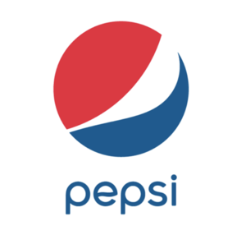



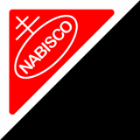



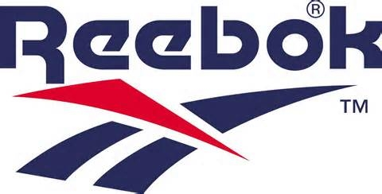




Some Satisfied Customers
www.trioenergyalliance.com

Slide 19
Some Hawaii
Satisfied Customers
Waihonua AOAO, Honolulu
Trump International Hotel, Waikiki
Island Colony AOAO, Waikiki
Ko’olau Conference Center, Kaneohe
Wet n Wild Hawaii, Kapolei
Honolulu Community College, Kalihi
Kuakini Medical Plaza, Honolulu
H-Power, C&C Honolulu, Kapolei
Meadow Gold Dairy, Honolulu
Pacific Guardian, Honolulu
Bank of Hawaii Waikiki Plaza, Waikiki
Hawaiian Humane Society, Honolulu
U.S.S. Missouri Battleship Museum, Honolulu
Diagnostic Laboratory Services, Inc., Honolulu
www.trioenergyalliance.com

Slide 20

Next Steps:
What Trio Energy Alliance Needs to Proceed
All pages of last 12 months utility bills
Completed Proposal Information Worksheet
www.trioenergyalliance.com

Slide 21
USES ® Authorized Distributor www.trioenergyalliance.com
Trio Energy Alliance, Inc.
Mark Ware, CTO
tech@trioenergyalliance.com
(208) 250-7048

